Slide 1
Booking4Groups
Deck
FROM: GRUMM Ltd

Slide 2
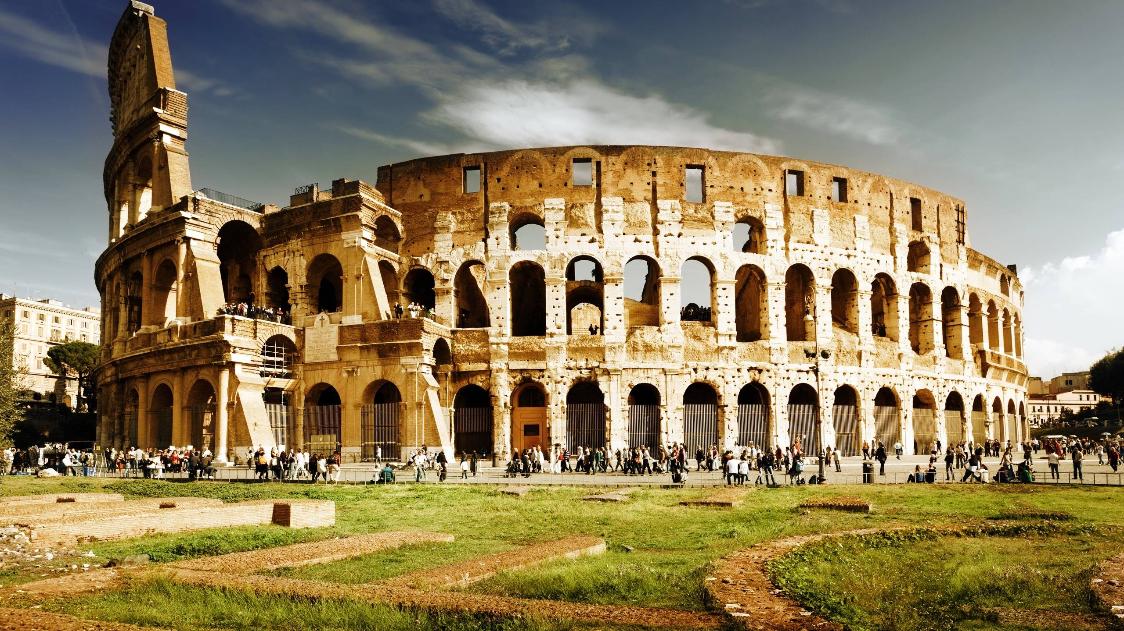
Booking4Groups
Executive Summary

Slide 3

Booking4Groups
Idea
The Idea was born when the founders discovered their potential of getting into a huge niche market that currently doesn’t hold any competitor. The project is based on the planning of group holiday booking while exploting the current available technologies
”More than a billion of people travel every year in the world for holiday purposes (4,5% more than in the year 2015, which equals to 50Mln+ travellers). Italy, with 81,5Mln of tourists every year, is in the 5° place, between the top touristic worldwide destinations (Just after France, USA, Spain and China). Italy is at the 7° place for revenues generated from tourist expenses, with 37Billions of Euro per year” . The Retail market, initially was mostly owned from “physical” tour agencies. Over time and with the arrival of new technologies, it became to be dominated from online agencies and companies such as: Booking.com, Expedia, edreams, airbnb, and many others. The average user is now able to plan a holiday by himself and without help from external third party companies that do the work for them, charging often extra fees. The situation is slighlty different when we talk about groups of people that are in need of an holiday, which often find hard to do as planning a vacation for over 10 people is often a difficult and complex procedure. This is why, people still ask for support from tour agencies. When agencies are unable to organise tours because the client has particular demands, the agencies go through other systems in the DMC in order to complete the bookings.
A destination management company (DMC) is a professional services company possessing extensive local knowledge, expertise and resources, specializing in the design and implementation of events, activities, tours, transportation and program logistics. According to a DMC company website a "DMC is a service professional company with a wide-range of knowledge and experience over the conditions and touristic resources of a region"[
(Reference: wikipedia)
Today. booking agencies and DMC still use ”old school” technologies to communicate and organise plans (e.g: Fax, calls, Emails). Planning a group tour is currently a complicated and slow process.
Booking4Groups was born to make the booking process easier, faster and more convenient for everyone that desires to organize a group trip. Easy as counting one-two-three. The platform allows whoever and whenever to book a trip/event for groups of people, in just a few clicks.

Slide 4

Innovation
Booking4Groups
A NEW CONCEPT OF “INVOICE”
Booking4Groups Made for the purpose of making easier, faster and more efficient bookings for groups of over 10 people.
On Booking4Groups we find two types of users: Clients and service providers. Service providers are: Hotels, restaurants, bus companies, tourist guide agencies and museums. Clients are usually Tour Operators that look for DMC and other organisations such as schools, parishes and business companies. Booking is extremely easy and after completing the registration, clients and service providers are immediately able to use the platform in full.
THE MAIN DIFFERENCE between Booking4Groupsand the current physical agencies, Is that clients is able to choose the service providers (hotel, restaurants, transport, guides) while offering their own monetary budget. Afterwards, the request is sent to all the service providers that match the client needs. The client will then receive a list of proposals and will be able to complete the booking and pay the initial deposit in a few clicks.

Slide 5

How it works
Booking4Groups
SIMPLICITY & EFFICIENCY
CHOOSE THE SERVICE
Specifying your budget
GET PROPOSALS
Fast
BOOK YOUR TOUR
And you’re ready to go!
For the client
Clients will be able to self-organise group tours at the most competitive prices, without ever exceeding their available budget. For the service provider
Providers will be able to to increase their clientele, filling up their premises with clients/guests and therefore raise their revenue significantly.
For Booking4Groups
The costs of the project development are the ones related to the creation of the B4G platform and marketing campaigns for clients acquisition.
THE BUSINESS MODEL: 12% Transaction Fee
BENEFITS
The Booking Process is extremely simple and straightforward. 1. The client request a service, writing a fixed budget who is willing to pay. He/she decides the amount of proposals to receive, from 1 to 5. In the following example, we will consider 3 as instance. 2. The B4G back-end system sends the request to all the service providers that match the client’s booking requirements. The service provider, when interested, is able to answer to the specific request by showing interest to the the proposal clicking on a link.. The first 3 providers that show interest by clicking on the link in their Email, will be the ones showed to the client. 3. The client chooses one of the 3 proposals and adds it to the cart, ready to pay at the checkout. Finally, when the cart is full, the client pays an initial deposit and ”booking confirmation” notification gets to the choosen service provider. The client meanwhile receives by Email all the details regarding the booking as a confirmation/reminder.

Slide 6

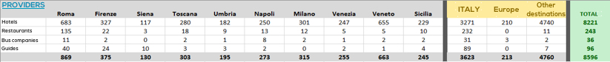
Go to market
Booking4Groups
A STRATEGIC ALLIANCE
The DMC company: TOURPLAN/IHZ Ltd is Partner e associate of booking4groups. IHZ is on the market, trading from the year 1964 with an extensive experience in the tourism indistry. The know-how, client traction and operativity of IHZ will be “transferred” into Booking4Groups, defining a decisive starting point and hence bringing revenue from day 1. Booking4Tour aim is also to expand the IHZ services across the globe, developing a multi-million tour booking company on a worldwide scale. The current outfit of service providers in TOURPLAN/IHZ:
IHZ has approximately 2500 clients. 300 of them made at least one booking during the past 12 months, generating a revenue of €5mln of Euro, with a net profit of €600,000. In order to acquire new clients and manage bookings related practices, we plan to set up a team of 6 [Full-Time] from Day 1. The procedure for increasing the number of potential client is related to a telephone/Email approach directed to: Tour Operators, Schools, Parishes, big corporations and Service providers such as: Hotels, Bus companies, Tour Guides, museums and other tourist settings (e.g: archeological sites, Shopping malls, and so on). Along with the face to face and phone to phone approach, we plan to run regular advertising campaigns on Social Networks and Search Engines such as Google

Slide 7


Team ed organizzazione
Booking4Groups
4 MESI PER ESSERE OPERATIVI
The development and management of Booking4Groups will be made from GRUMM Ltd, which will bring the platform for clients and Admin back-office panel into a fully operative status within 4 Months.
The Booking4Groups Team will be made of:
- OPERATIONAL OFFICE
- 1 COO
- CUSTOMER SUPPORT / BOOKING MANAGEMENT
- 4 Members
- BUSINESS DEVELOPMENT, MARKETING, SOCIAL MEDIA & COMMUNICATIONS
- 2 Members
- ADMINISTRATION
- 1 Admin Secretary

Slide 8

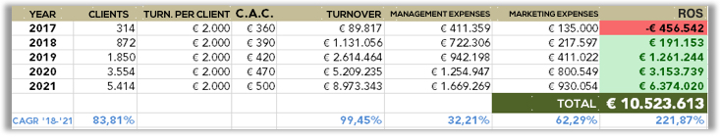
Booking4Groups
Finance
WINNING THE MARKET
This is a summary of our financial plan for the next 5 years which shows the forecast of Booking4groups without any further investment a part from the one descripted below: We are reserving a 20% share to whom will become a future shareholder in exchange of 500.000€
We have estimated that the Booking4Groups will become profitable in the 8° Month from the trading start date. The shareholder/investor payback will be reached on or before the 36° month after the trading start date.

Slide 9
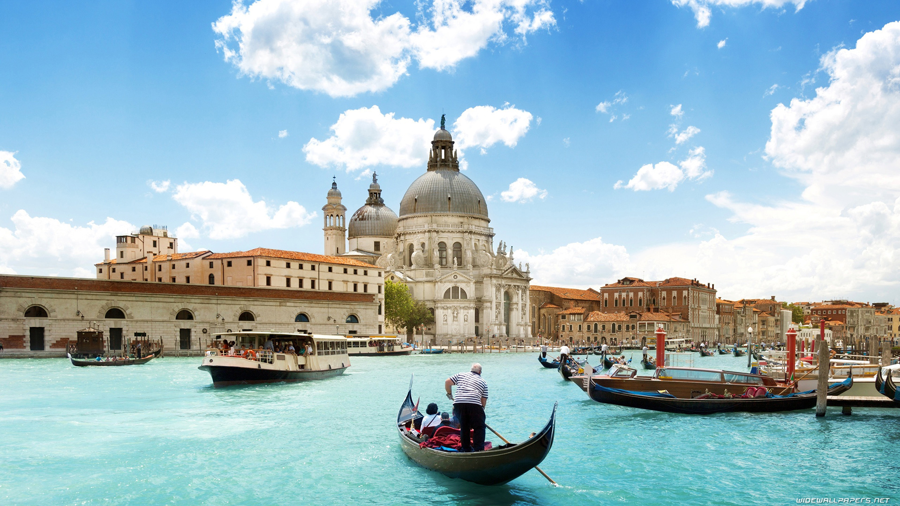
Booking4Groups
Thanks for your time…

